Slide 1

Vaccines for My Baby
During Pregnancy

Slide 2
Influenza

Slide 3

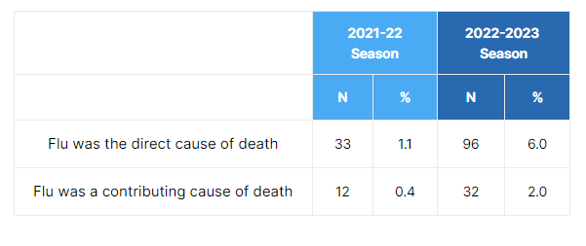
Influenza (flu)
Flu virus is one bad bug!
Kansas Resident Influenza Related Deaths
by Selected Entire Flu Seasons
(Time period based on date of death)
From KDHE Influenza Surveillance: https://www.kdhe.ks.gov/1476/Influenza-Surveillance

Slide 4
Influenza (flu)
Flu disease can cause severe problems for a fetus, newborn, or pregnant woman.

Slide 5

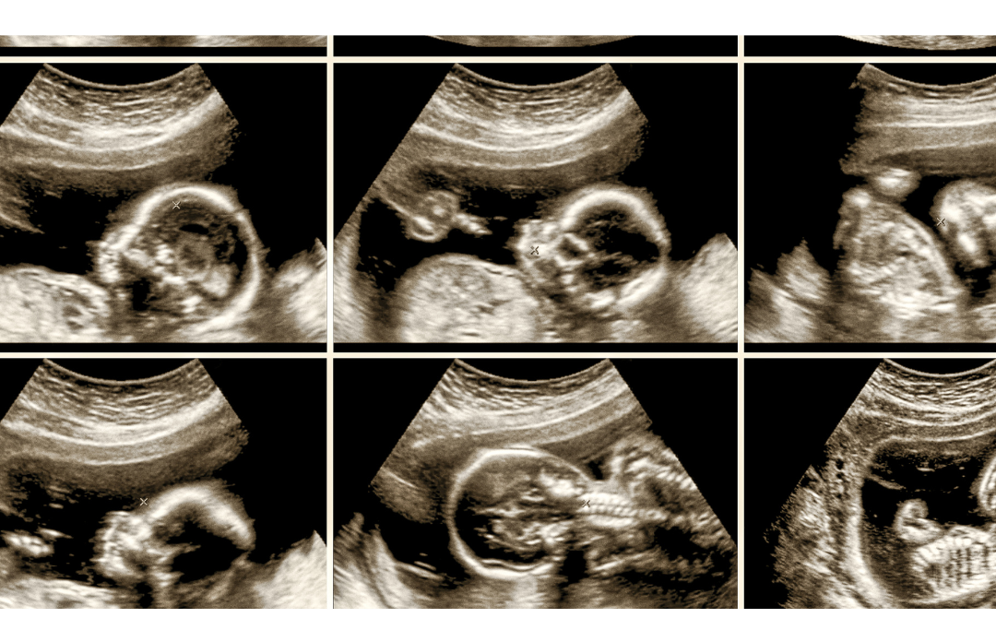
Influenza (flu)
"The embryo or fetus might be affected adversely by influenza in the mother during pregnancy, especially when the mother is severely ill."
From the American Journal of Obstetrics & Gynecology
Prenatal flu infection was significantly associated with late pregnancy loss and reduction in mean birthweight of term, singleton infants.
If a pregnant woman in any trimester is hospitalized for flu during influenza season, it can harm her fetus. Her infant is more likely to be born small for gestational age and to have lower mean birthweight than infants born to women who did not need hospitalization.
Pandemic flu infection during pregnancy was associated with an increased risk of fetal death. Vaccination during pregnancy reduced the risk of an influenza diagnosis.
Notes:
"The embryo or fetus might be affected adversely by influenza in the mother during pregnancy, especially when the mother is severely ill."
From the Am Journal of Obstetrics & Gynecology(opens in a new tab)
In a study published in the Lancet Infectious Diseases, prenatal flu infection was significantly associated with late pregnancy loss and reduction in mean birthweight of term, singleton infants.
Source(opens in a new tab)
If a pregnant woman in any trimester is hospitalized for flu during influenza season (a proxy for influenza illness) it can harm her fetus. Her infant is more likely to be born small for gestational age and to have lower mean birthweight than infants born to women who did not need hospitalization.
Source(opens in a new tab)
In a very large Norwegian study, pandemic flu infection during pregnancy was associated with an increased risk of fetal death. Vaccination during pregnancy reduced the risk of an influenza diagnosis.
Source

Slide 6
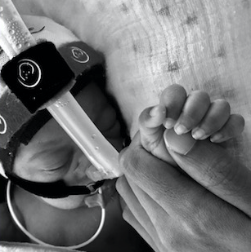

The Story of Anakin Das
Anakin was born 10 weeks premature as a result of his mother contracting influenza while pregnant. He now suffers from chronic lung disease.
Read the full story: familiesfightingflu.org/family-story/the-das-family/

Slide 7

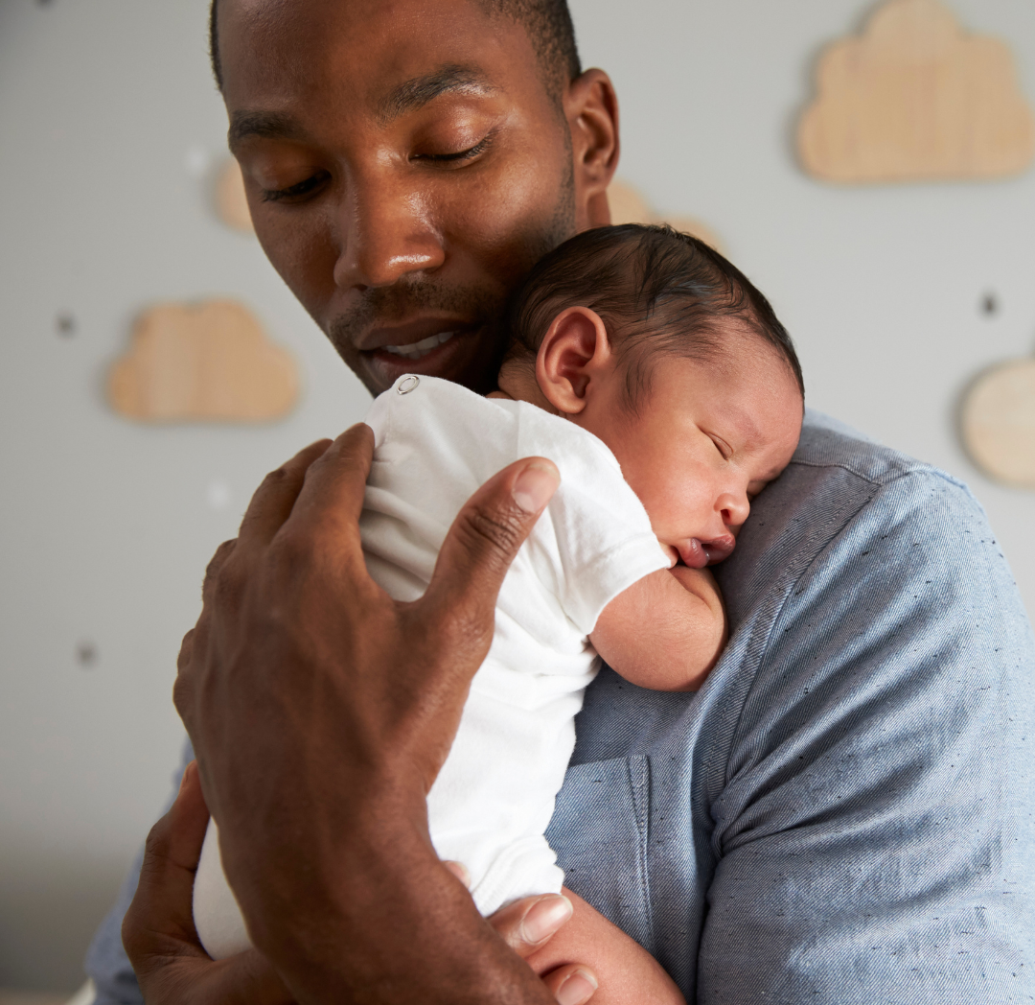
Influenza (flu)
On average each year in the U.S.
6,514 infants less than 12 months of age are hospitalized for influenza.
Age: The younger the infant the greater the risk of hospitalization from influenza. Hospitalization rates among
Otherwise healthy: Most hospitalizations occurred in otherwise healthy infants (75%) among whom up to 10% were admitted to the ICU and up to 4% had respiratory failure.
  These proportions were 2–3 times higher in infants with high-risk conditions (such as congenital heart, lung, or neuromuscular disorders).
Notes:
On average each year in the U.S. 6,514 infants less than 12 months of age are hospitalized for influenza. (Range 1,842 to 12,502). (Infants are eligible for the 1st flu vaccine at age 6 months and for the 1st DTaP in the primary series at age 2 months.)
Age: The younger the infant the greater the risk of hospitalization from influenza.
Hospitalization rates among infants <3 months were substantially higher than the rate in older infants. Infants <6 months were 40% more likely to be admitted to the ICU than older infants.
Otherwise healthy: Most hospitalizations occurred in otherwise healthy infants (75%) among whom up to 10% were admitted to the ICU and up to 4% had respiratory failure. Of course, these proportions were 2–3 times higher in infants with high risk conditions (such as congenital heart, lung, or neuromuscular disorders).
Source

Slide 8
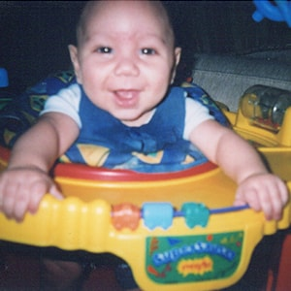
Marques Jackson’s Flu Story
5½-month-old Marques Jackson, Jr. came down with a fever and a runny nose and symptoms of what his family thought was just a common cold. After a visit to the doctor, it was determined that Marques had influenza.
Over the next 24 hours, his symptoms got worse. Marques began having trouble breathing so his parents called 911. As Marques was being rushed to the hospital he suffered from several small strokes.
Marques died in the hospital from complications of influenza, just four days after his first symptom.
Notes:
On December 24, 2003, 5½-month-old Marques Jackson, Jr. came down with a fever and a runny nose and symptoms of what his family thought was just a common cold. After a visit to the doctor, it was determined that Marques had influenza.
Over the next 24 hours, his symptoms got worse. Marques began having trouble breathing so his parents called 911. As Marques was being rushed to the hospital he suffered from several small strokes.
Marques died in the hospital from complications of influenza on December 28, 2003, just four days after his first symptom appeared. Because of his young age, Marques could not get vaccinated against the flu.
This tragedy has made Marques’ mother and grandfather crusaders for yearly influenza vaccinations. Today, every adult and child in their family gets vaccinated against the flu.

Slide 9

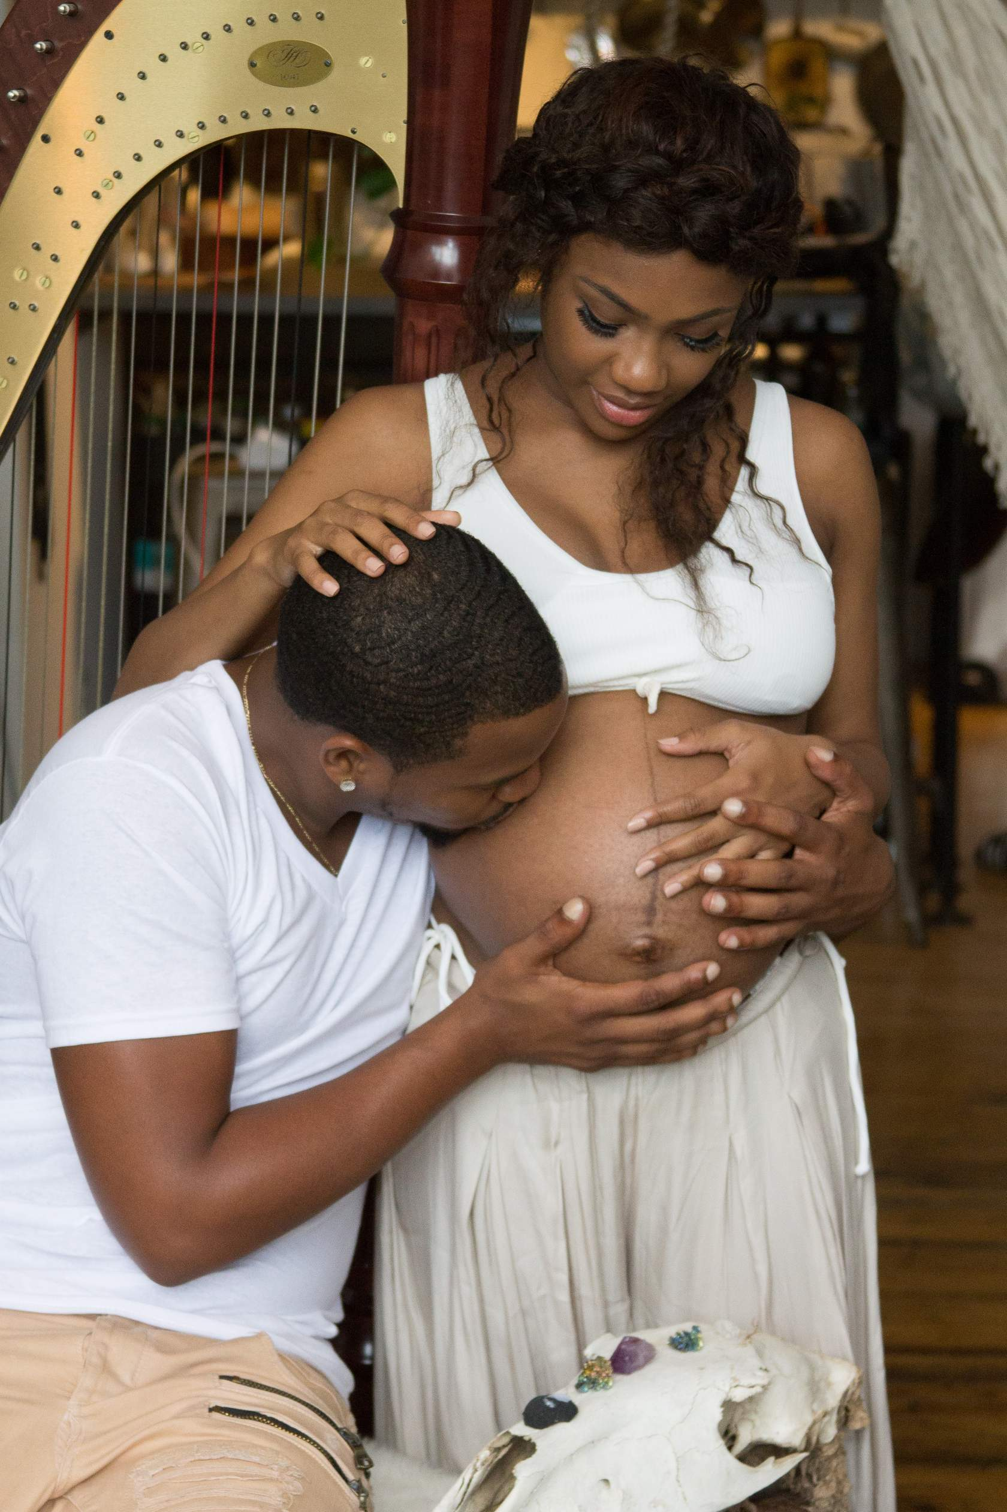
Influenza (flu)
Flu is more likely to cause severe illness in pregnant women than in non-pregnant women of reproductive age.
Changes in the immune system, heart, and lungs make pregnant women and women up to 2 weeks postpartum more prone to severe illness from flu, including illness resulting in hospitalization.
Among U.S. deaths reported to CDC due to the 2009 influenza pandemic, 5% of all these deaths involved pregnant women, even though pregnant women represented <1% of the U.S. population.
Notes:
Flu is more likely to cause severe illness in pregnant women than in non-pregnant women of reproductive age.
Changes in the immune system, heart, and lungs during pregnancy make pregnant women and women up to 2 weeks postpartum more prone to severe illness from flu, including illness resulting in hospitalization. Pregnant women with influenza also are at an increased risk of intensive care unit admission.
ACOG Summary Document(opens in a new tab); Systematic Review Article(opens in a new tab)
For example, among U.S. deaths reported to CDC due to the 2009 influenza pandemic , 5% of all these deaths involved pregnant women, even though pregnant women represented <1% of the U.S. population.
JAMA

Slide 10
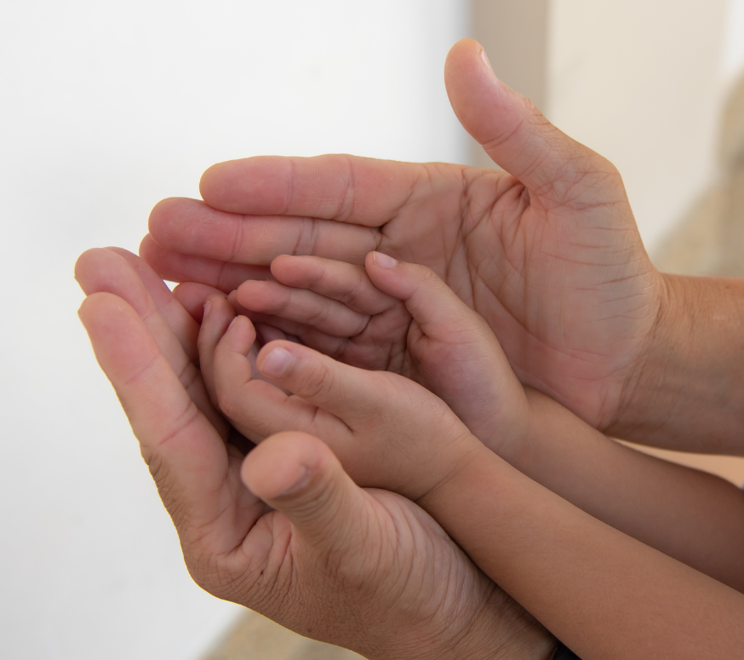
Influenza (flu)
When you get a flu shot, you help to protect your fetus, your newborn, and yourself.
Within 2 weeks of a flu shot, a mother's antibodies against flu pass to the fetus through the placenta.
In this way, maternal vaccination offers protection via antibody transmission through the placenta and, postpartum, through breast milk.
Because babies <6 months of age cannot receive flu vaccine, this indirect protection is currently the best prevention strategy for newborns.
The flu vaccine also reduces a pregnant woman's risk of severe influenza requiring hospitalization and ICU care.
Notes:
Within 2 weeks of a flu shot, a mother's antibodies against flu pass to the fetus through the placenta. In this way, maternal vaccination offers protection via antibody transmission through the placenta and, postpartum, through breast milk.
Source(opens in a new tab)
Because babies <6 months of age cannot receive flu vaccine, this indirect protection is currently the best prevention strategy for newborns.
The flu vaccine also reduces a pregnant woman's risk of severe influenza requiring hospitalization and ICU care.
Source

Slide 11
The Facts about 3 Common Concerns
1. "Does flu vaccine really work?”
2. "The flu vaccine gives me the flu.”
3. “Is flu vaccine really safe during pregnancy?”

Slide 12
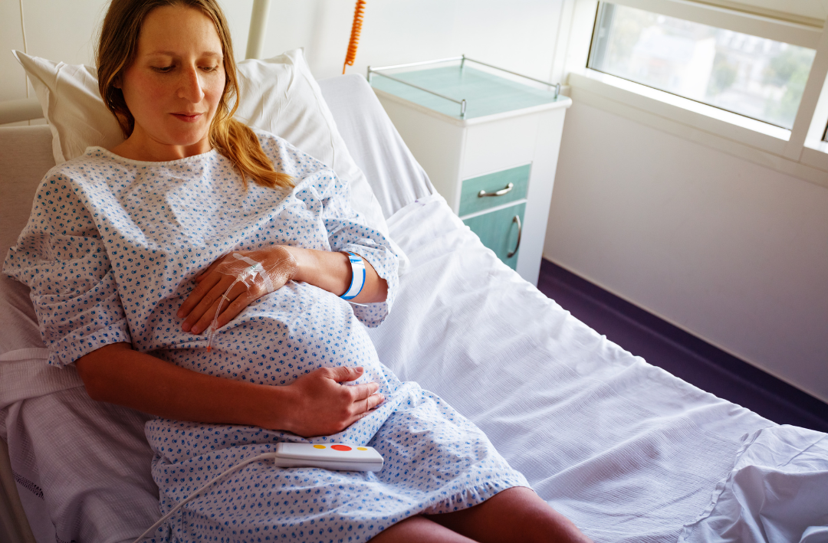
Concern #1: “Does flu vaccine really work?”
Vaccination reduces the risk of flu-associated acute respiratory infection in pregnant women by about half. (CDC)
The real issue, though, is the risk a pregnant woman faces when she gets influenza infection: her infection may be so severe that she needs hospital care.
How much does flu vaccination help to prevent this? Take a guess!
Getting a flu shot will reduce a pregnant woman’s risk of being hospitalized with flu by an average of _____ %
A: 10%
B: 20%
C: 30%
D: 40%
Notes:
Vaccination has been shown to reduce the risk of flu-associated acute respiratory infection in pregnant women by about one-half. (CDC data(opens in a new tab))
The real issue, though, is the risk a pregnant woman faces when she gets influenza infection: her infection may be so severe that she needs hospital care. How much does flu vaccination help to prevent this?
The answer is 40%!

Slide 13
Concern #1: “Does flu vaccine really work?”
Vaccination reduces the risk of flu-associated acute respiratory infection in pregnant women by about half. (CDC)
The real issue, though, is the risk a pregnant woman faces when she gets influenza infection: her infection may be so severe that she needs hospital care.
How much does flu vaccination help to prevent this? Take a guess!
Getting a flu shot will reduce a pregnant woman’s risk of being hospitalized with flu by an average of _____ %
A: 10%
B: 20%
C: 30%
D: 40% A 2018 study evaluated the effectiveness of the flu vaccine and found that getting a flu shot reduced a pregnant woman’s risk of being hospitalized with flu by an average of 40%.
Notes:
Vaccination has been shown to reduce the risk of flu-associated acute respiratory infection in pregnant women by about one-half. (CDC data(opens in a new tab))
The real issue, though, is the risk a pregnant woman faces when she gets influenza infection: her infection may be so severe that she needs hospital care. How much does flu vaccination help to prevent this?
The answer is 40%!

Slide 14
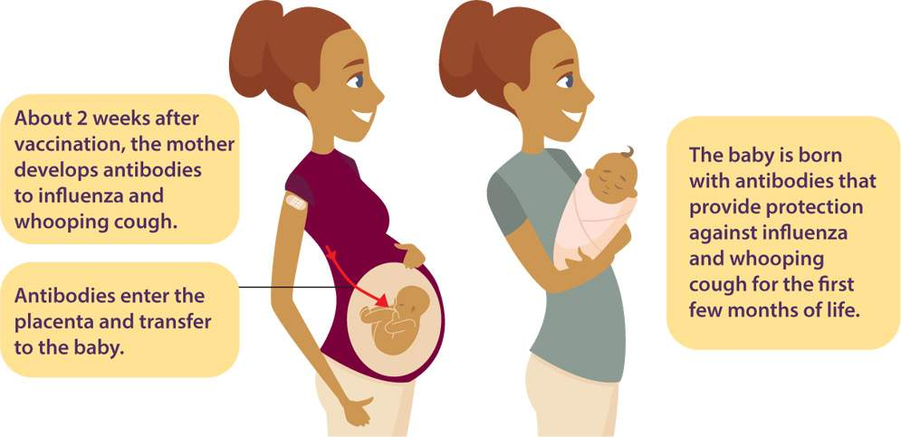
Concern #1: “Does flu vaccine really work?”
For influenza vaccine and Tdap the transfer of protective antibodies is an important vaccine effect.
Notes:
For influenza vaccine and Tdap the transfer of protective antibodies is an important vaccine effect.
Maternal vaccination leads to protection of infants, which is key because... Young infants are at high risk of having complications if infected with flu

Slide 15
Concern #1: “Does flu vaccine really work?”
Maternal vaccination leads to protection of infants, which is key because…
A: Young infants are at high risk of having complications if infected with flu
B: Infants are not eligible for flu vaccine until 2 months of age
C: Both statements are true
Notes:
Quiz time! Maternal vaccination leads to protection of infants, which is key because... Young infants are at high risk of having complications if infected with flu

Slide 16
Concern #1: “Does flu vaccine really work?”
Maternal vaccination leads to protection of infants, which is key because…
A: Young infants are at high risk of having complications if infected with flu
B: Infants are not eligible for flu vaccine until 2 months of age
C: Both statements are true
Notes:
Quiz time! Maternal vaccination leads to protection of infants, which is key because... Young infants are at high risk of having complications if infected with flu. If they are infected with flu, young infants often need emergency or hospital care .

Slide 17
Concern #1: “Does flu vaccine really work?”
Maternal vaccination leads to protection of infants, which is key because…
A: Young infants are at high risk of having complications if infected with flu
B: Infants are not eligible for flu vaccine until 2 months of age
C: Both statements are true
Note: Babies are not eligible for flu vaccine until 6 months of age, so they must rely on maternal immunization.
Notes:
Babies are not eligible for flu vaccine until 6 months of age, so they have to rely on maternal immunization.
NOTE: Infants may receive their 1st dose of DTaP at 2 months of age, but most infants are not immune to pertussis until they receive a few doses of DTaP, so maternal immunization against pertussis is also important.

Slide 18
When you get a flu shot, you help to protect your fetus, your newborn, and yourself.
Notes:
Within 2 weeks of a flu shot, a mother's antibodies against flu pass to the fetus through the placenta. In this way, maternal vaccination offers protection via antibody transmission through the placenta and, postpartum, through breast milk.
Because babies <6 months of age cannot receive flu vaccine, this indirect protection is currently the best prevention strategy for newborns.
The flu vaccine also reduces a pregnant woman's risk of severe influenza requiring hospitalization and ICU care.

Slide 19
Concern #2: “The flu vaccine gives me the flu.”
There is no living virus in the vaccine.
The flu vaccine provides the best protection the baby will have against flu for their first 6 months of life.
May have minor effects to your immune system the next day, but that’s better than being hospitalized.
Notes:
The flu shot cannot give you a flu infection. There is no living virus in the vaccine.
OBs, family medicine doctors, and midwives want you to get this during pregnancy... partly to protect you, but also because it provides the best protection the baby will have against flu for their first 6 months of life.
The shot may stir up your immune system so you don't feel 100% tomorrow, but that's not as bad as a getting the flu infection during pregnancy. PLUS it will decrease the chances that your baby will get the flu, and that's very important.

Slide 20
Evidence of flu shot safety during pregnancy

Slide 21
Concern #3: “Is the flu shot safe for me and my baby during pregnancy?”
Yes! Flu shots have been given to millions of pregnant women over many years with a good safety record.
A review of VAERS (Vaccine Adverse Event Reporting System) reports found no evidence to suggest a link between flu vaccination of pregnant women and pregnancy complications or poor fetal outcomes.
Notes:
Yes! Flu shots have been given to millions of pregnant women over many years with a good safety record.
A review of reports to the Vaccine Adverse Event Reporting System found no evidence to suggest a link between flu vaccination of pregnant women and either pregnancy complications or poor fetal outcomes.
Below are brief summaries of some evidence regarding the flu shot's safety during pregnancy. Many of the studies were done using the Vaccine Safety Database (VSD)(opens in a new tab), a research collaboration between eight health care organizations and CDC.

Slide 22
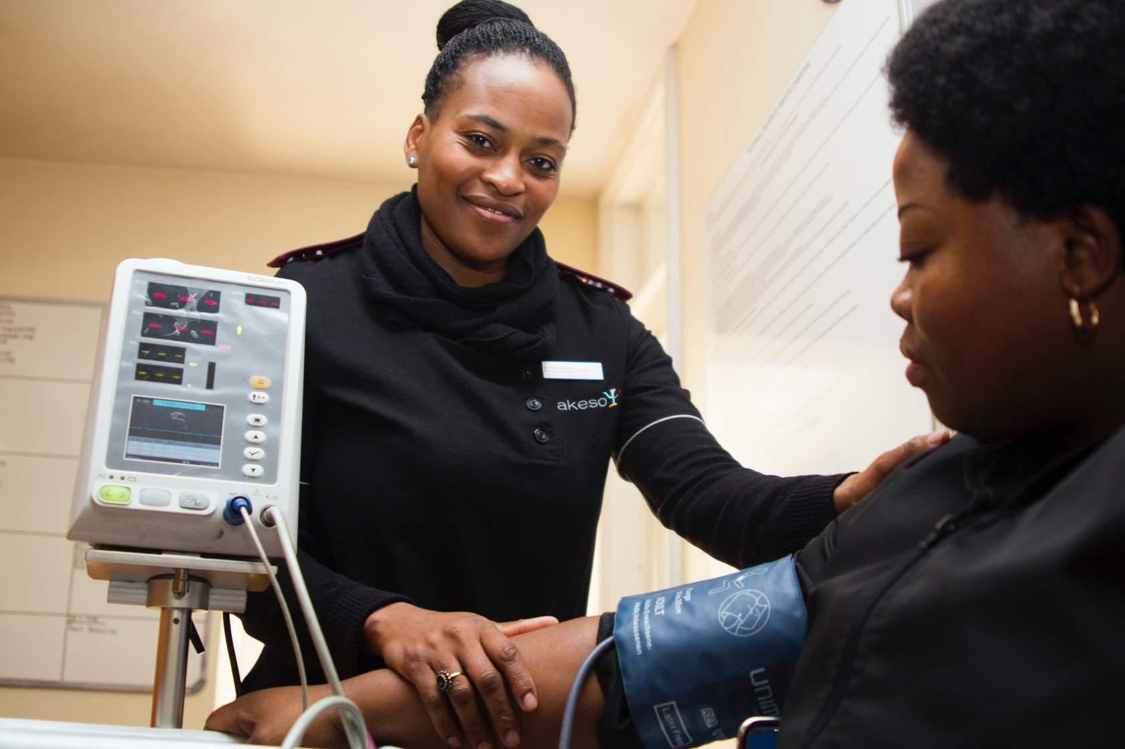
No increased risk for adverse events or miscarriage during pregnancy
A large study found no increased risk for adverse events for pregnant women who received the flu vaccine from 2002 to 2009 when compared to pregnant woman who were not vaccinated.
A large study using data from three flu seasons (2012-13, 2013-14, 2014-15) found no increased risk for miscarriage after flu vaccination during pregnancy.
A similar study using data from the 2005-06 and 2006-07 seasons found no increased risk of miscarriage among pregnant women who received flu vaccines.
Notes:
A large study found no increased risk for adverse events for pregnant women who received the flu vaccine from 2002 to 2009 when compared to pregnant woman who were not vaccinated.
A A large study using data from three flu seasons (2012-13, 2013-14, 2014-15) found no increased risk for miscarriage after flu vaccination during pregnancy. (Donahue et al, 2019)
https://www.sciencedirect.com/science/article/pii/S0264410X19312447
A similar study using data from the 2005-06 and 2006-07 seasons found no increased risk of miscarriage among pregnant women who received flu vaccines. (Irving et al, 2013)
https://pubmed.ncbi.nlm.nih.gov/23262941/

Slide 23

One flawed study received widespread media attention
One study examined data from the 2010-2011 and 2011-2012 flu seasons. The team thought they found an association between flu vaccination early in pregnancy and an increased risk of spontaneous abortion.
Notes:
A large study using data from three flu seasons (2012-13, 2013-14, 2014-15) found no increased risk for miscarriage after flu vaccination during pregnancy. (Donahue et al, 2019)
https://www.sciencedirect.com/science/article/pii/S0264410X19312447
A similar study using data from the 2005-06 and 2006-07 seasons found no increased risk of miscarriage among pregnant women who received flu vaccines. (Irving et al, 2013)
https://pubmed.ncbi.nlm.nih.gov/23262941/
One study examined data from the 2010-2011 and 2011-2012 flu seasons. The team thought they found an association between flu vaccination early in pregnancy and an increased risk of spontaneous abortion.

Slide 24
One flawed study received widespread media attention
  The study had some major problems, though:
    Women with complicated pregnancies are more likely to be followed closely by a doctor.
    The small sample size led to imprecise results.
    This study was the only analysis to show this reported association; no other studies have found an increased risk of spontaneous abortion following influenza vaccination.
In response to this study, the CDC provided funding for a larger 2019 follow-up study that included about three times as many women. That study did not find any safety problems.
Notes:
The study had some major problems, though :
Women with complicated pregnancies (and consequently at greater risk of miscarriage) also were more likely to be followed closely by a doctor (and consequently more likely to be vaccinated). Once an analysis was done that controlled for this important confounding factor, the "association" was no longer there.
The small sample size led to imprecise results.
This study was the only analysis to show this reported association; no other studies have found an increased risk of spontaneous abortion following influenza vaccination.
See Ault & Riley.pdf below this block.
In response to this study CDC provided funding for the larger 2019 follow-up Vaccine Safety Datalink (VSD) study (described above) that included about three times as many women. That study did not find any safety problems.

Slide 25
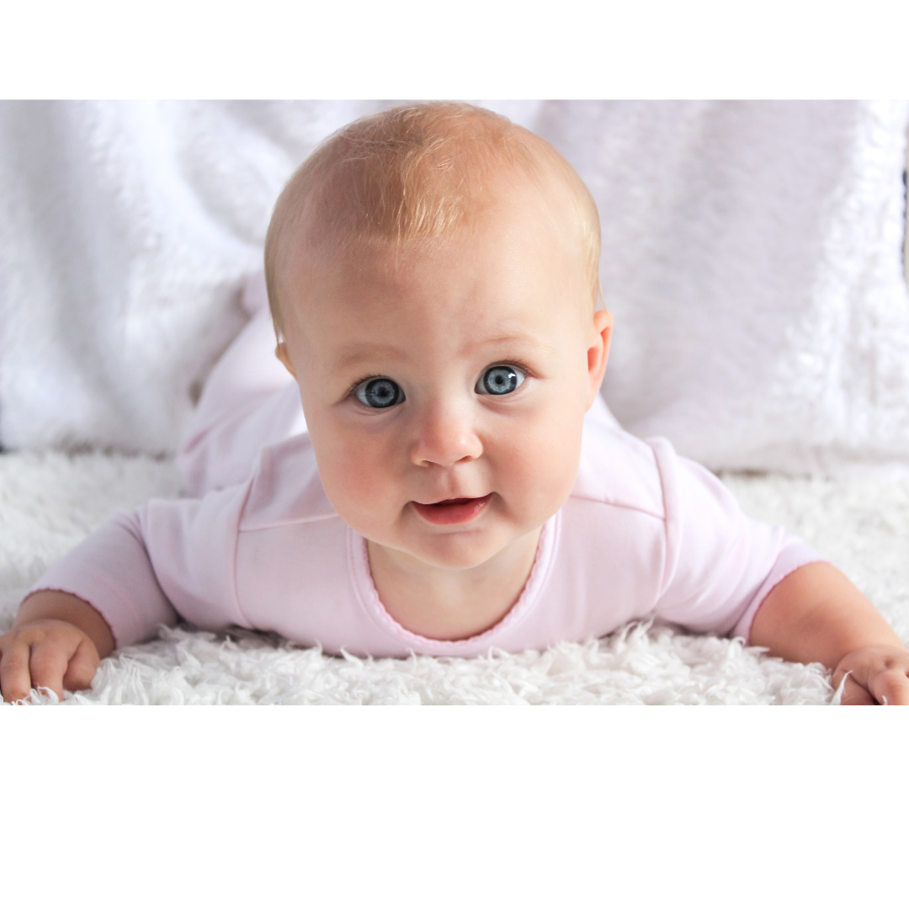
No increased risk of premature delivery or birth defects
In a study of pregnant women who received the flu shot and an equal number of pregnant women who did not receive the flu shot, there was no difference between the two groups in the rates of premature delivery or small for gestational age infants.
A large 2017 study found that the babies of women who received the flu shot during their first trimester had no increased risk of having children with major birth defects.
Notes:
In a study of pregnant women who received the flu shot compared with an equal number of pregnant women who did not receive the flu shot during the 2004-05 and 2008-09 flu seasons, there was no difference between the two groups in the rates of premature delivery or small for gestational age infants.
A large 2017 study found that the babies of women who received the flu shot during their first trimester had no increased risk of having children with
major birth defects.

Slide 26
More on flu vaccine safety

Slide 27
To sum up flu vaccine safety:
The flu shot is safe for pregnant women and the fetus.
  Much safer than going without the flu shot and just hoping for the best!
"I don't want flu vaccine's side effects."
  Interestingly, in a study where people did not know if they got a flu shot or a placebo, there were no differences in terms of body aches, fever, cough, runny nose or sore throat.
Notes:
To sum up flu vaccine safety: The flu shot is safe for pregnant women and the fetus.
The flu shot is much safer than going without the flu shot and just hoping for the best.
"I don't want flu vaccine's side effects."
Interestingly, in a study where people did not know if they got a flu shot or a placebo, among people who got the flu shot there was more arm soreness and redness at the injection site . There were no differences in terms of body aches, fever, cough, runny nose or sore throat.

Slide 28
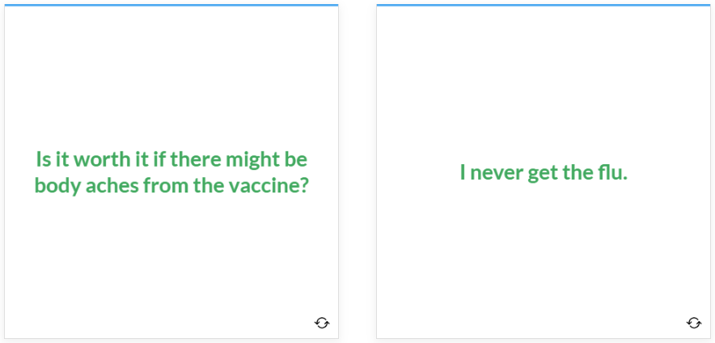
Common Concerns
Notes:
Is it worth it if there might be body aches from the vaccine?
You may feel achy, but you'll pass antibodies to the baby.
I never get the flu.
Your immune system, heart, and lungs are not like they were before your pregnancy. If you get flu this year you could need support in the hospital, which is hard on the baby.

Slide 29
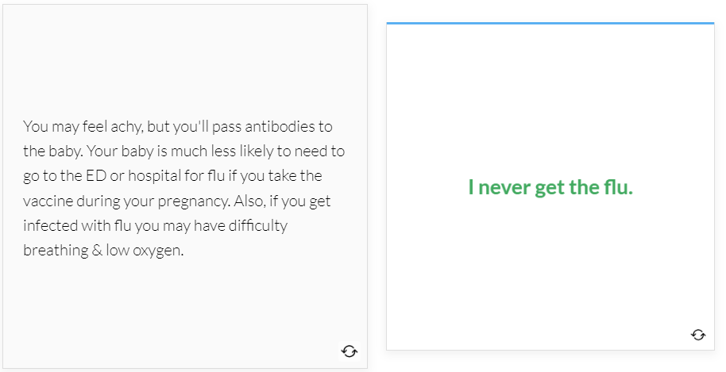
Common Concerns
Notes:
Is it worth it if there might be body aches from the vaccine?
You may feel achy, but you'll pass antibodies to the baby.
I never get the flu.
Your immune system, heart, and lungs are not like they were before your pregnancy. If you get flu this year you could need support in the hospital, which is hard on the baby.

Slide 30
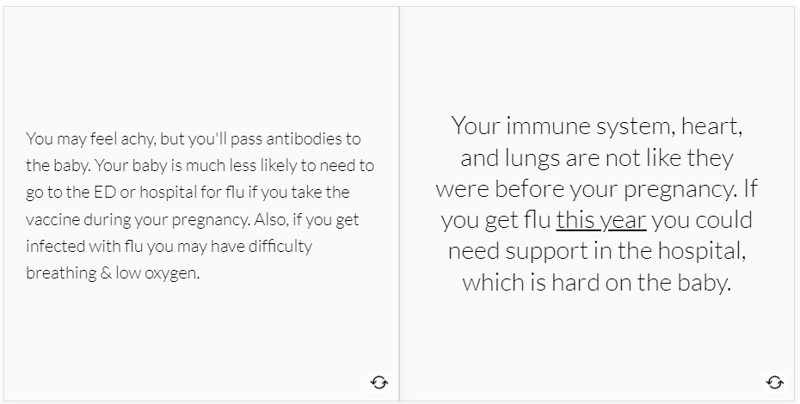
Common Concerns
Notes:
Is it worth it if there might be body aches from the vaccine?
You may feel achy, but you'll pass antibodies to the baby.
I never get the flu.
Your immune system, heart, and lungs are not like they were before your pregnancy. If you get flu this year you could need support in the hospital, which is hard on the baby.

Slide 31
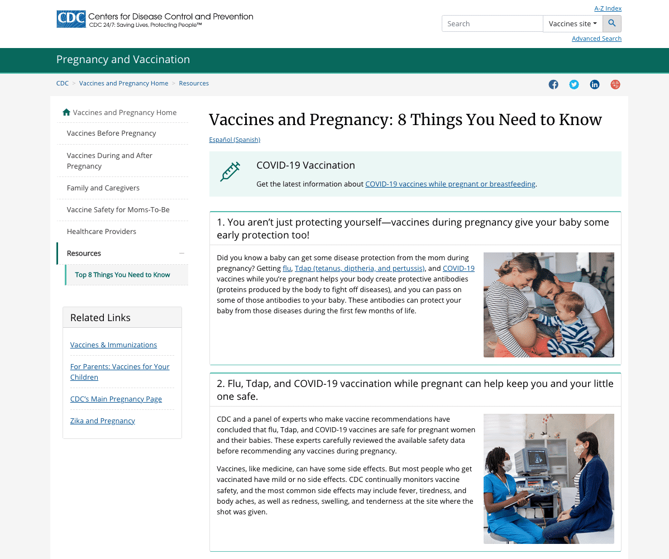
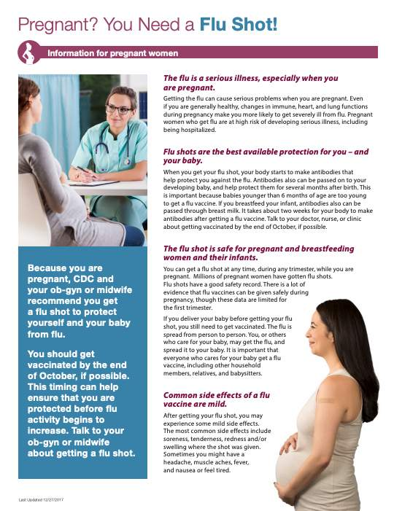
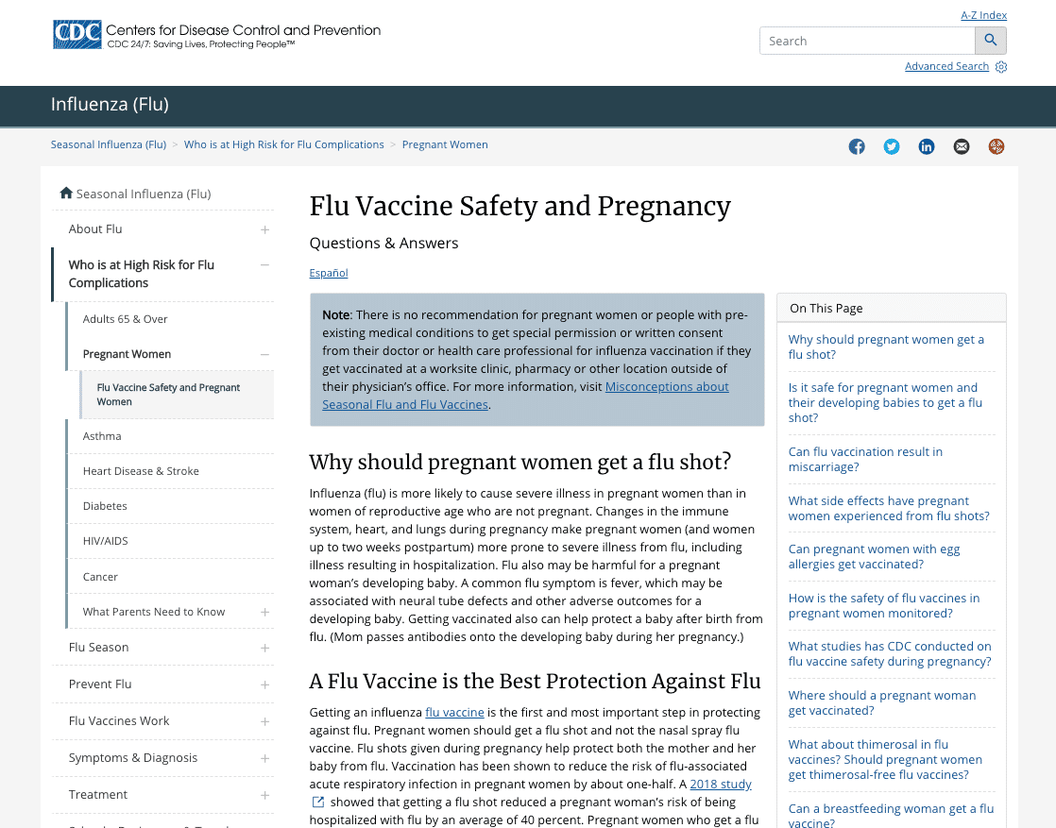
More reading for you
Vaccines and Pregnancy: 8 Things You Need to Know
"Pregnant? You Need a Flu Shot!
"Flu Vaccine Safety and Pregnancy: Questions & Answers"
Notes:
More reading for you

Slide 32
Pertussis

Slide 33
Pertussis
Why get Tdap vaccine during pregnancy?
  Outbreaks of pertussis (whooping cough) occur across the U.S.
  Today’s pertussis vaccines are not long-lasting, so we need to focus on protecting infants, the group most at risk of pertussis.
  The Tdap vaccine is best received between the 27th and 36th week of each pregnancy.
Notes:
Why get Tdap vaccine during pregnancy?
Outbreaks of pertussis (whooping cough) were occurring across the U.S.
Today’s pertussis vaccines are not long-lasting, so we need to focus on protecting infants, the group most at risk of pertussis. Infants can have severe, life-threatening complications with whooping cough.
Why get Tdap vaccine during the 27th through 36th week of each pregnancy?
(best during the earlier part of this time period)

Slide 34
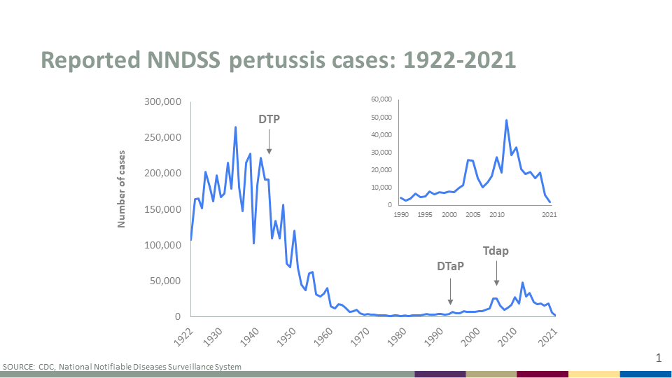
Pertussis Trends
There was a recent U.S. resurgence of pertussis. Each year from 2010-2019, CDC received 10,000-50,000 case reports of pertussis, and every state reported a case
In 2012, there were 48,277 reported cases of pertussis; 2,269 of those cases were in infants younger than 3 months and 15 of those infants died.
Notes:
Each year since 2010, CDC has received 10,000 to 50,000 case reports of pertussis and every state has reported cases.
In 2012, there were 48,277 reported cases of pertussis; 2,269 of those cases were in infants younger than 3 months and 15 of those infants died.

Slide 35
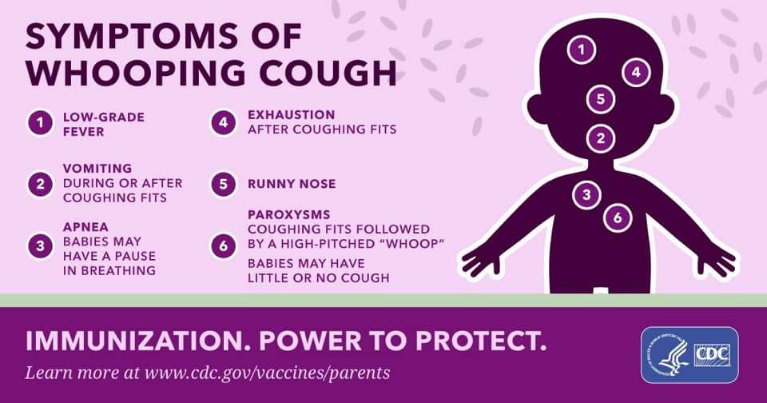
Pertussis is more than a cough
In infants <1 year of age who get pertussis, about half need hospital care. Of those infants, about
61% will have episodes when the baby stops breathing
23% will develop pneumonia
1% will die
Most pertussis deaths are infants who are too young to be protected by the childhood pertussis vaccine (DTaP).
Notes:
In infants <1 year of age who get pertussis, about half need hospital care. The younger the infant, the more likely they will need hospital care.
Of those infants hospitalized with pertussis, about
61% will have episodes when the baby stops breathing
23% will develop pneumonia
1% will die
In recent years, up to 20 infants have died from pertussis each year in the US.
Most pertussis deaths are infants who are too young to be protected by the childhood pertussis vaccine (DTaP).

Slide 36
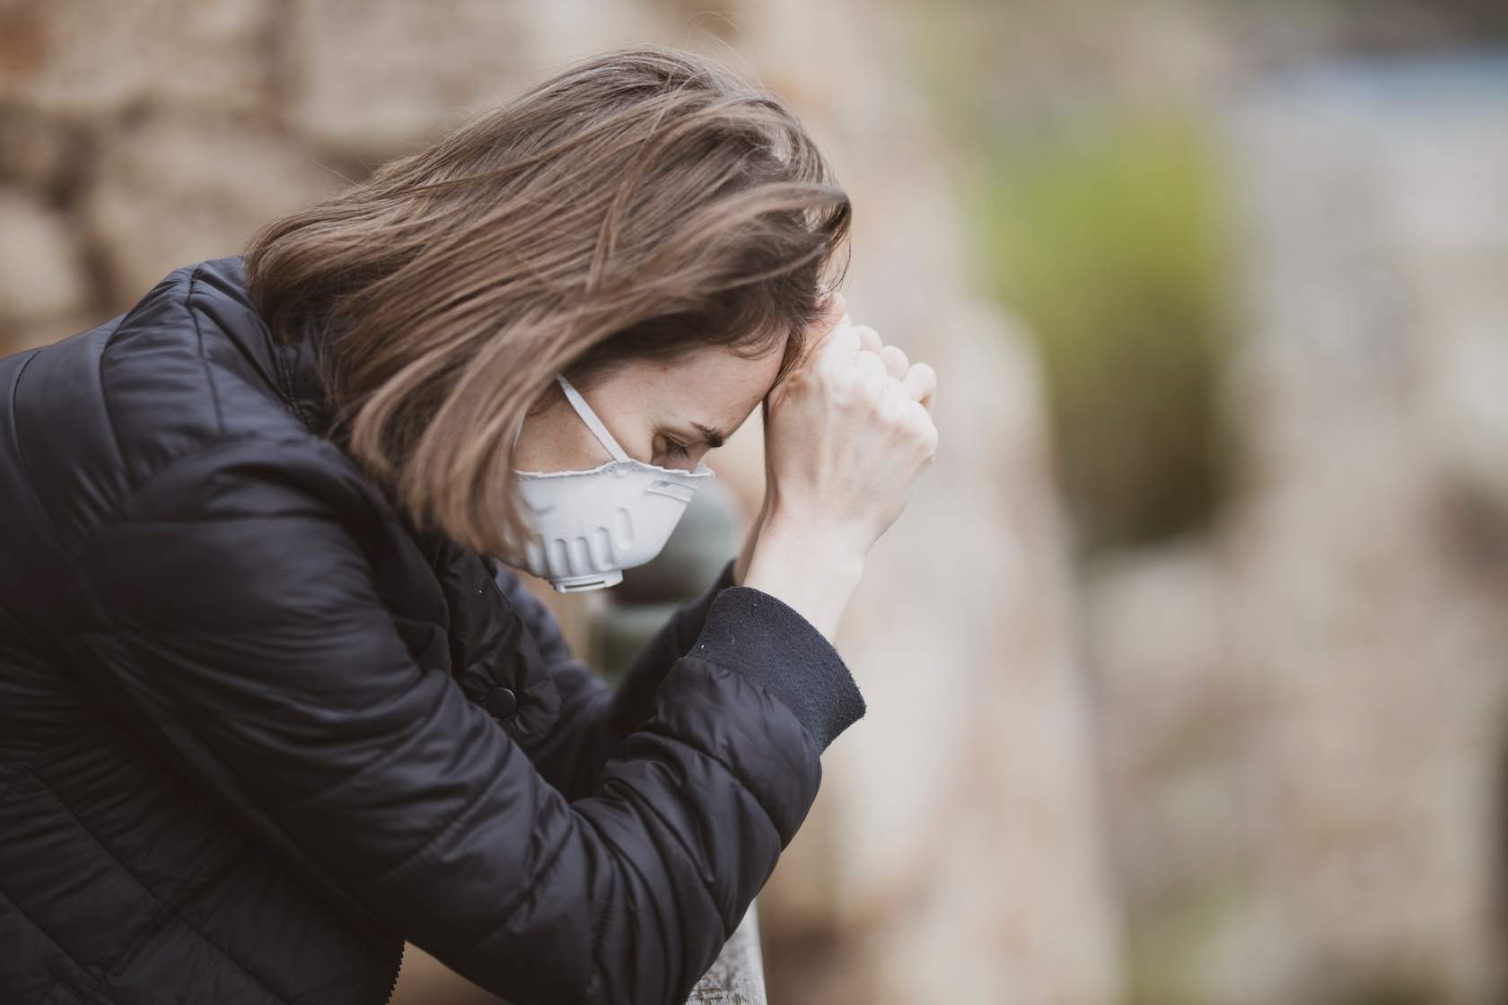
The 100 day cough: pertussis in adults
Pregnant women can also have complications from pertussis.
The pertussis cough can last for 3 months. Adults can cough so hard it causes:
  Urinary incontinence
  Fainting
  Broken rib
Notes:
Pregnant women – and all adolescents and adults -- can also have complications from pertussis. Usually the disease is less serious in this age group, especially in those who had the vaccine series as a child, but it can happen.
The pertussis cough can last for 3 months. Adults can cough so hard it causes
Urinary incontinence (wet yourself) (28%)
Fainting (6%)
Broken rib (4%)

Slide 37
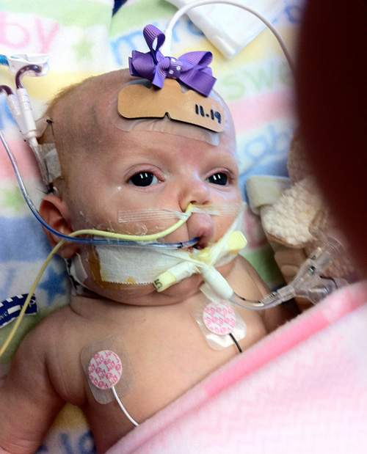
Babies can’t start pertussis shot until age 2 months
There are no pertussis vaccines for newborns.
Steps to take to prevent pertussis:
  Mothers get Tdap vaccine during pregnancy.
  Make sure family and others around the infant are up to date with Tdap vaccine.
  Give the baby DTaP series starting at 2 months of age.
Notes:
There are no pertussis vaccines for newborns. We must take other steps to prevent pertussis in a young infant.
Mothers get Tdap vaccine during pregnancy.
Make sure father, grandparents, day care workers, and others around the infant are up to date with Tdap vaccine.
Give the baby DTaP series starting at 2 months of age.

Slide 38
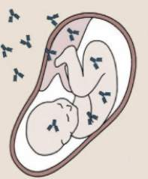
Vaccination during pregnancy leads to protection
Mother's pertussis antibodies go from vaccinated mother to fetus through the placenta. This gives the newborn some protection against pertussis.
Vaccination of the mother AFTER delivery does NOT provide this direct protection for the infant.
Notes:
Mother's pertussis antibodies go from vaccinated mother to fetus through the placenta. This gives the newborn some protection against pertussis.
The infant develops immunity before they are able to start the primary DTaP series at 2 months of age.
Vaccination of the mother AFTER delivery does NOT provide this direct protection for the infant.

Slide 39
When you receive Tdap vaccine during pregnancy, you pass antibodies to your baby.
It’s the best way to protect your newborn from whooping cough.

Slide 40
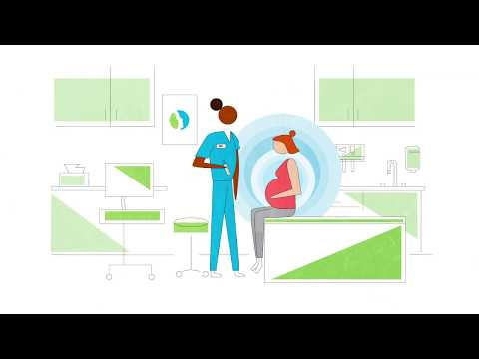
AWHONN Tdap Vaccine Video
Notes:
Watch the video from the Association of Women's Health, Obstetric and Neonatal Nurses (AWHONN).
This reviews why pregnant women should get the vaccine every pregnancy between 27-38 weeks gestation.

Slide 41
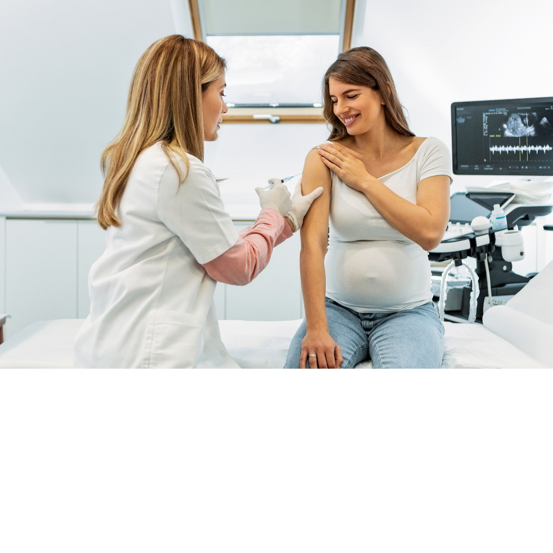
Tdap Questions
When is the best time for me to get Tdap vaccine?
  The most antibody gets to the infant if Tdap vaccine is given between 27 and 36 weeks of gestation, but Tdap may be given at any time during pregnancy.
  Many offices give Tdap vaccine at the same visit they do the test for gestational diabetes.
  If you think you have not gotten it by then, ask about it.
Is Tdap safe during pregnancy?
  Yes! This has been tracked and there are no extra side effects for the woman or her unborn baby when Tdap vaccine is given during pregnancy.
Notes:
When is the best time for me to get Tdap vaccine?
The most antibody gets to the infant if Tdap vaccine is given between 27 and 36 weeks of gestation, but Tdap may be given at any time during pregnancy.
Many offices give Tdap vaccine at the same visit they do the test for gestational diabetes.
If you think you have not gotten by then, ask about it.
Is Tdap safe during pregnancy?
Yes! This has been tracked and there are no extra side effects for the woman or her unborn baby when Tdap vaccine is given during pregnancy.

Slide 42
Answers to 6 vaccine questions

Slide 43
6 Common Vaccine Questions
“I don’t believe in vaccines.”
“I’m not worried about flu or pertussis.”
“I’m worried about vaccine side effects if given during pregnancy.”
“Can’t I just get vaccinated after my delivery?”
“Isn’t it enough to make sure everyone around my baby is vaccinated?”
“If I plan to breastfeed, do I still need to vaccinated during pregnancy?”

Slide 44
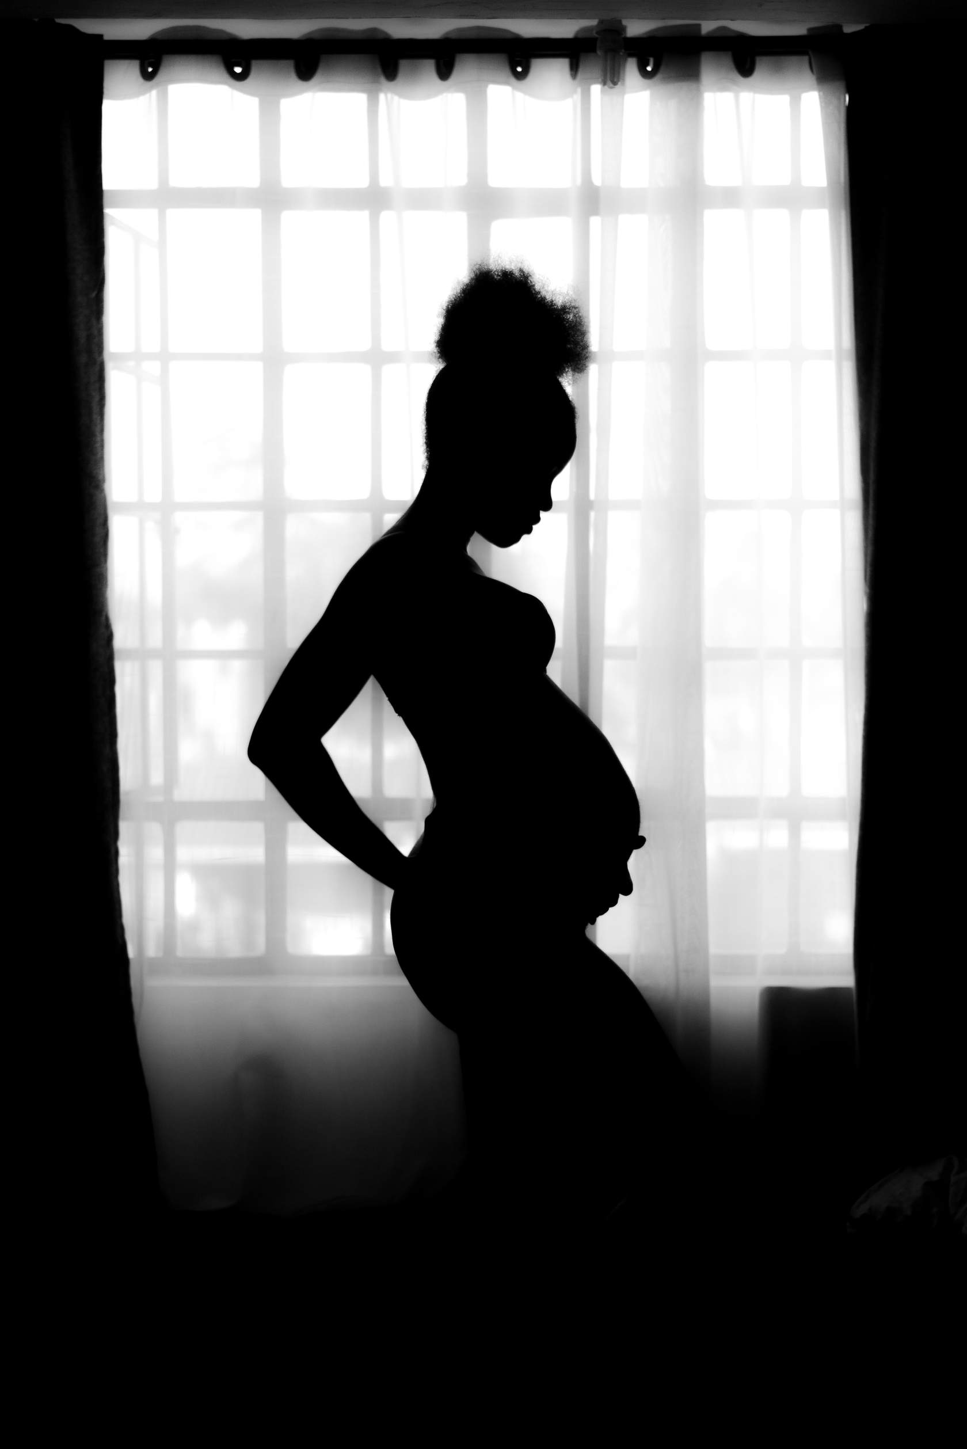
“I don’t believe in vaccines.”
Your body is different during pregnancy. Most importantly, getting flu vaccine and Tdap can give your baby early protection against serious illnesses.
Notes:
Even if you don't usually take vaccines, during pregnancy is the time to do this because your body is different now. Most importantly, getting flu vaccine and Tdap during pregnancy can give your baby early protection against serious illnesses.

Slide 45

“I’m not worried about flu or pertussis.”
Flu and whooping cough are very dangerous for young babies and can even be deadly. Even healthy women can end up in the hospital if they catch the flu.
Notes:
Flu and whooping cough are very dangerous for young babies and can even be deadly. Also, even healthy women can end up in the hospital if they catch the flu.

Slide 46
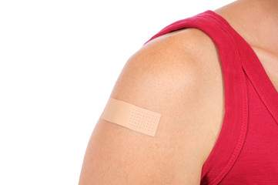
“I’m worried about vaccine side effects if given during pregnancy.”
Most side effects from vaccines against flu and pertussis are mild and last a day or two.
Notes:
Most side effects from vaccines against flu and pertussis are mild and last a day or two. It’s mostly just redness, swelling, and tenderness where you got the shot. You may feel tired or achy, which shows the vaccine is stirring up your immune system as it should.

Slide 47

“Can’t I just get vaccinated after my delivery?”
The vaccines you get during pregnancy will help protect you and your baby during their early months of life, when babies can’t yet get their own vaccines.
Later, babies will get their own vaccines when your antibodies leave them.
Notes:
The vaccines you get during pregnancy will help protect you and your baby during their early months of life, when babies can’t yet get their own vaccines.
After vaccination it takes about 14 days for antibody levels to rise, so don't wait for the last minute before delivery to get protection for the baby!
Later, babies will get their own vaccines to protect them when your antibodies leave them.
(Babies can get their first flu vaccine at 6 months of age and their first whooping cough shot at 2 months of age.)

Slide 48

“Isn’t it enough to make sure everyone around my baby is vaccinated?”
It’s almost impossible to make sure that no one around your baby will spread flu or pertussis.
Vaccines during pregnancy offer the best protection for your baby until they're old enough to get their own vaccines.
Notes:
If your baby doesn't have the antibodies from you, it's hard to protect them. It’s almost impossible to make sure that no one around your baby will spread flu or pertussis.
Vaccines during pregnancy offer the best protection for your baby until they're old enough to get their own vaccines.

Slide 49
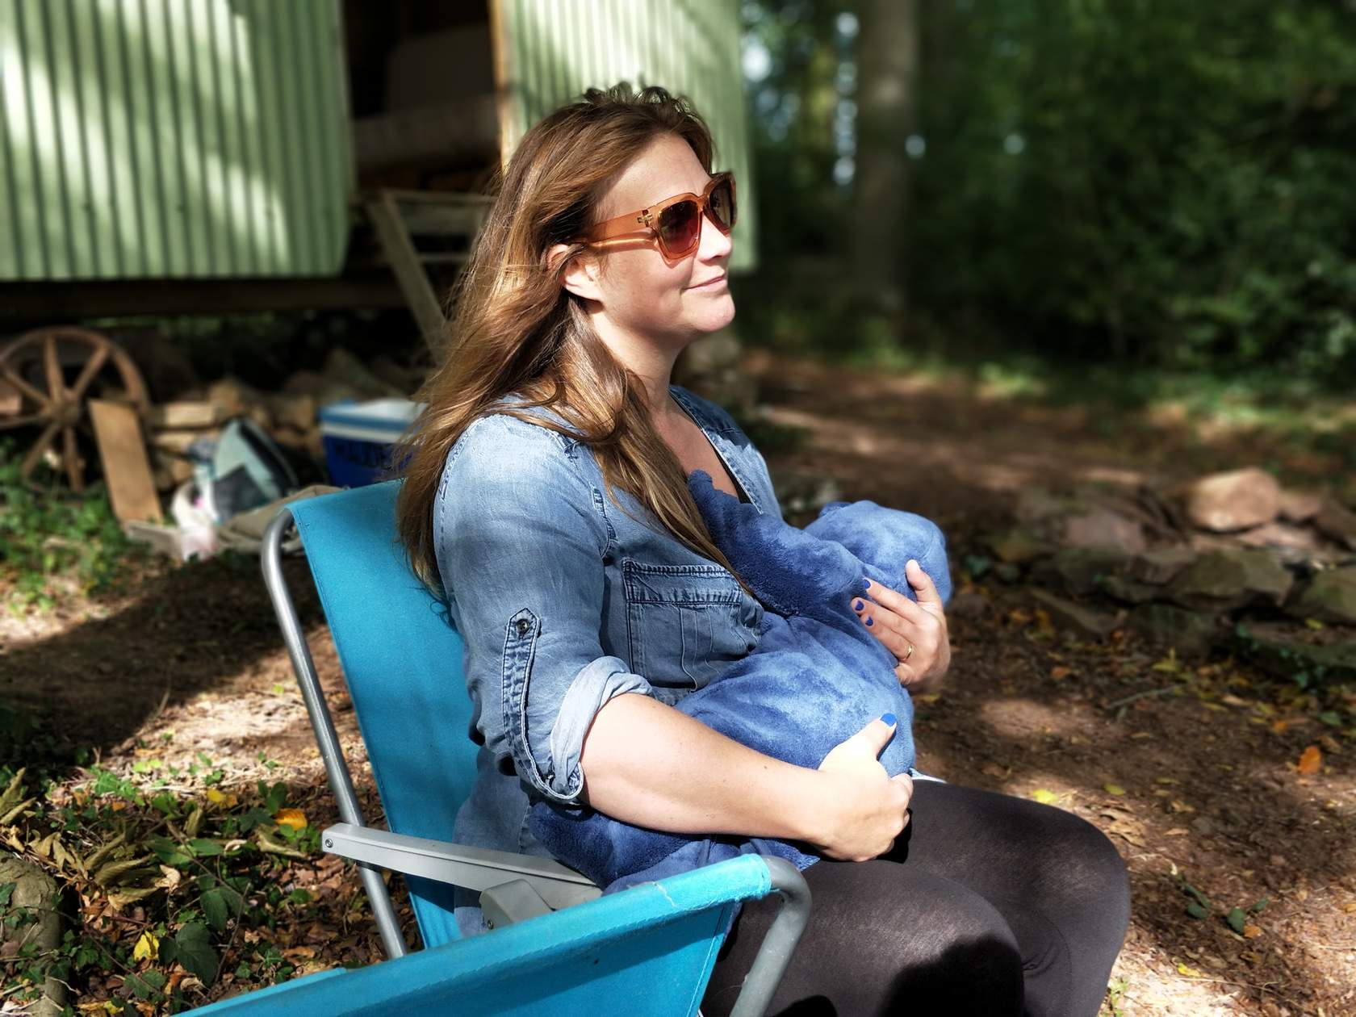
“If I plan to breastfeed, do I still need vaccination during pregnancy?”
When you get vaccinated during your pregnancy, you will have protective antibodies in your breast milk that you can share with your baby.
However, your baby will not get immediate or the greatest number of protective antibodies if you wait to get a whooping cough vaccine until after delivering your baby.
Breast milk only offers limited and short-term protection, so it’s important for baby to start their own vaccines on time.
Notes:
- Yes, you still need vaccination during pregnancy.
- You can pass some protection to your baby by breastfeeding. When you get a whooping cough vaccine during your pregnancy, you will have protective antibodies in your breast milk that you can share with your baby.
- However, your baby will not get immediate or the greatest number of protective antibodies if you wait to get a whooping cough vaccine until after delivering your baby. This is because it takes about 2 weeks after you get the vaccine before your body develops high levels of antibodies.
- Unfortunately, breast milk only offers limited and short-term protection, so it’s very important for your baby to start their own vaccines on time.

Slide 50
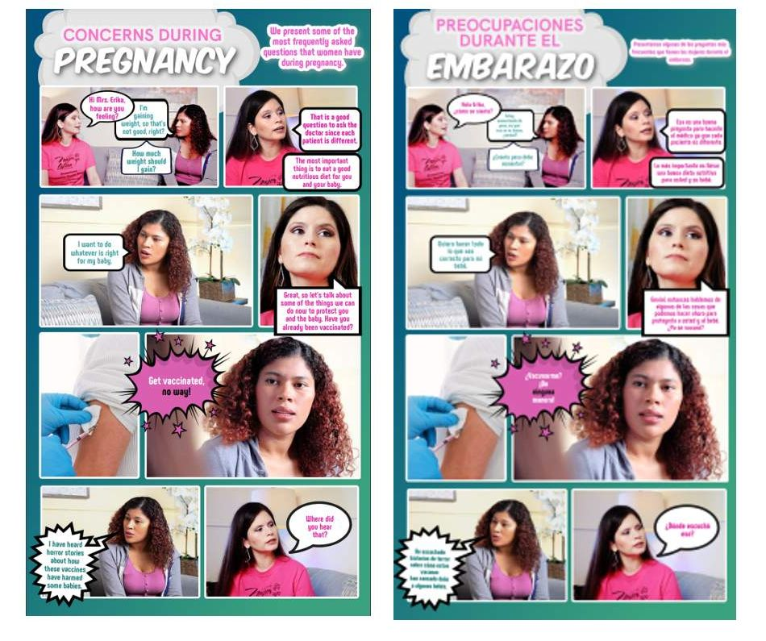
Fotonovela Resource
Vaccinate Your Family & Día de la Mujer Latina created a fotonovela answering common questions and concerns about vaccines during pregnancy.
Printable versions (para imprimir):
  Español
  English
Notes:
Vaccinate Your Family & Día de la Mujer Latina
This team created a fotonovela answering common questions and concerns about vaccines during pregnancy. A fotonovela is a short graphic novel with a social message illustrated with photographs, art, and text, that is a popular form of media in Latin American culture.
Printable versions (para imprimir):
Español(opens in a new tab)
English

Slide 51
COVID-19 vaccination during pregnancy

Slide 52

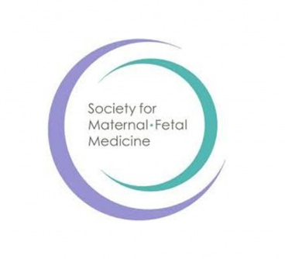
COVID-19 vaccination during pregnancy
COVID-19 vaccination is recommended for pregnant and lactating women by leading obstetric care specialist organizations
  American College of Obstetricians and Gynecologists (ACOG)
  Society for Maternal-Fetal Medicine (SMFM)
Notes:
The two leading organizations that represent obstetric care specialists are the American College of Obstetricians and Gynecologists (ACOG) and the Society for Maternal-Fetal Medicine (SMFM). They recommend that all age-eligible persons, including pregnant and lactating individuals, receive a COVID-19 vaccine series.
https://www.acog.org/clinical/clinical-guidance/practice-advisory/articles/2020/12/covid-19-vaccination-considerations-for-obstetric-gynecologic-care(opens in a new tab)
https://www.acog.org/news/news-releases/2021/07/acog-smfm-recommend-covid-19-vaccination-for-pregnant-individuals
Here are the three main reasons for their recommendation.

Slide 53
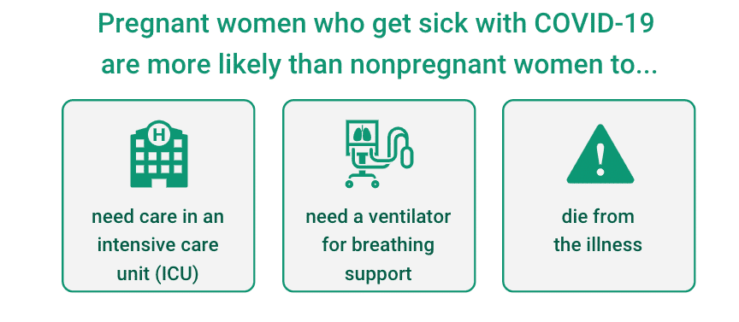
Reason #1: The burden of disease

Slide 54
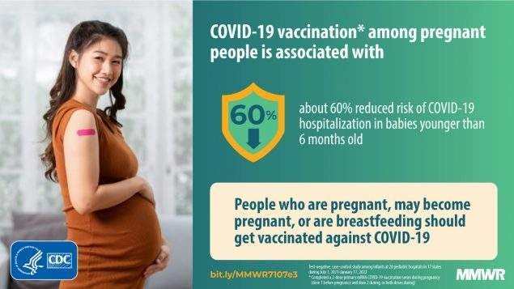
Reason #2: COVID-19 vaccines work
Estimated vaccine effectiveness for symptomatic infection was 97% after the second dose.
COVID-19 vaccination during pregnancy can help protect the baby, too!
Notes:
COVID-19 vaccination during pregnancy helps the baby, too!
A recent small study found that at 6 months old, most infants (57%) born to pregnant people who were vaccinated during pregnancy had detectable antibodies against COVID-19, compared to only 8% of infants born to pregnant people who had COVID-19 disease during pregnancy.
The estimated vaccine effectiveness for symptomatic infection was 97% in days 7–56 after the second dose. This helps keep the pregnant patient and fetus safe.
Plus, it helps keep others in the home and community safe.

Slide 55
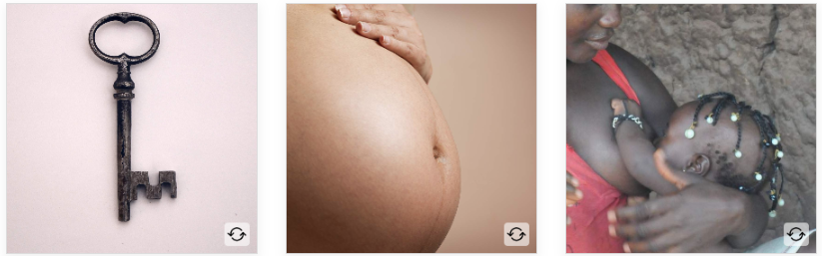
Reason #3: COVID-19 vaccines are safe
Notes:
COVID vaccines cannot give you COVID-19 because there is no live virus in the vaccine
Reports show that women who got COVID-19 vaccine during pregnancy did not have vaccine safety problems
After vaccination, the antibodies made by your body may be passed through breastmilk, helping to protect your baby from COVID-19

Slide 56
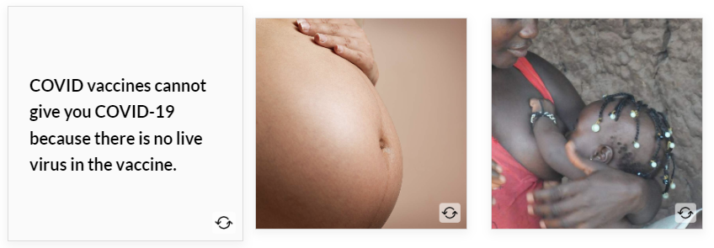
Reason #3: COVID-19 vaccines are safe
Notes:
COVID vaccines cannot give you COVID-19 because there is no live virus in the vaccine
Reports show that women who got COVID-19 vaccine during pregnancy did not have vaccine safety problems
After vaccination, the antibodies made by your body may be passed through breastmilk, helping to protect your baby from COVID-19

Slide 57
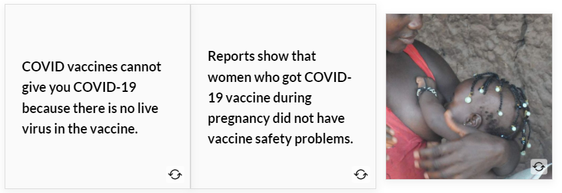
Reason #3: COVID-19 vaccines are safe
Notes:
COVID vaccines cannot give you COVID-19 because there is no live virus in the vaccine
Reports show that women who got COVID-19 vaccine during pregnancy did not have vaccine safety problems
After vaccination, the antibodies made by your body may be passed through breastmilk, helping to protect your baby from COVID-19

Slide 58
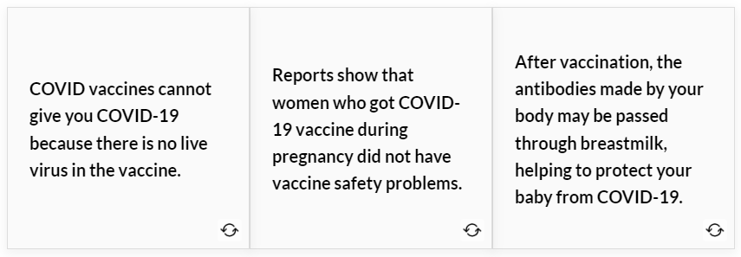
Reason #3: COVID-19 vaccines are safe
Notes:
COVID vaccines cannot give you COVID-19 because there is no live virus in the vaccine
Reports show that women who got COVID-19 vaccine during pregnancy did not have vaccine safety problems
After vaccination, the antibodies made by your body may be passed through breastmilk, helping to protect your baby from COVID-19

Slide 59
Reason #3: COVID-19 vaccines are safe
You should know…
Your ability to get pregnant remains the same after COVID-19 vaccination.
O.B.s recommend vaccination for anyone who may consider getting pregnant in the future.
Notes:
You should know…
Your ability to get pregnant remains the same after COVID-19 vaccination.
O.B.s recommend vaccination for anyone who may consider getting pregnant in the future.

Slide 60
RSV Protection for Baby

Slide 61

What is respiratory syncytial virus (RSV)?
RSV is a virus that causes breathing problems. It is most dangerous in babies and the elderly.
RSV season- In most regions of the United States, RSV season starts in the fall and peaks in the winter, but the timing and severity of RSV season can vary from place to place and year to year.

Slide 62
Why does your baby need protection from RSV?
RSV infection is very common. Almost all infants get it in the first two years of life.
Two to three out of every 100 infants with RSV infection need hospital care. They may need oxygen, I.V. fluids (if they aren’t eating and drinking), or even mechanical ventilation (a machine to help with breathing). Most babies improve with this kind of support and can be discharged to home in a few days.

Slide 63
Current RSV Recommendations

Slide 64
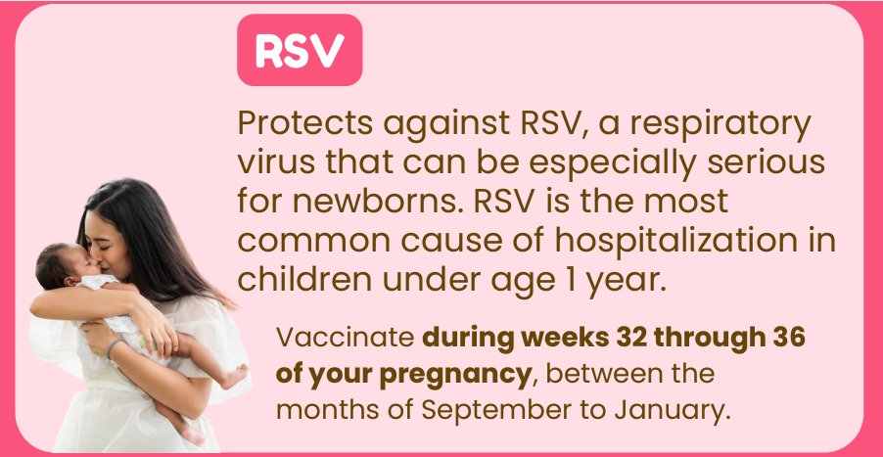
Option #1: Vaccination of the mother during pregnancy
ACOG recommends the Pfizer RSV vaccine if you are 32 to 36 weeks pregnant from September to January.
The vaccine helps your body create antibodies that pass to your fetus. Your baby will have some antibodies to protect them from RSV for the first 6 months after birth.
Notes:
Photo source: IKC’s Vaccine Highlight Card found: https://immunizekansascoalition.org/documents/Pregnancy%20Vaccine%20Insert%20-%20web.pdf

Slide 65
Option #2: Giving the infant antibody before or during RSV season
If the mother did not get the RSV vaccine during pregnancy, the infant should receive the RSV antibody in an injection called nirsevimab.
The RSV protective antibody is given to protect babies from getting very sick with RSV during their first RSV season.
In most of the continental United States, this means giving the antibody from October through March.
Even infants born during the RSV season should receive a single dose of the RSV antibody within 1 week after birth.
Notes:
Photo source: IKC’s Vaccine Highlight Card found: https://immunizekansascoalition.org/documents/Pregnancy%20Vaccine%20Insert%20-%20web.pdf

Slide 66
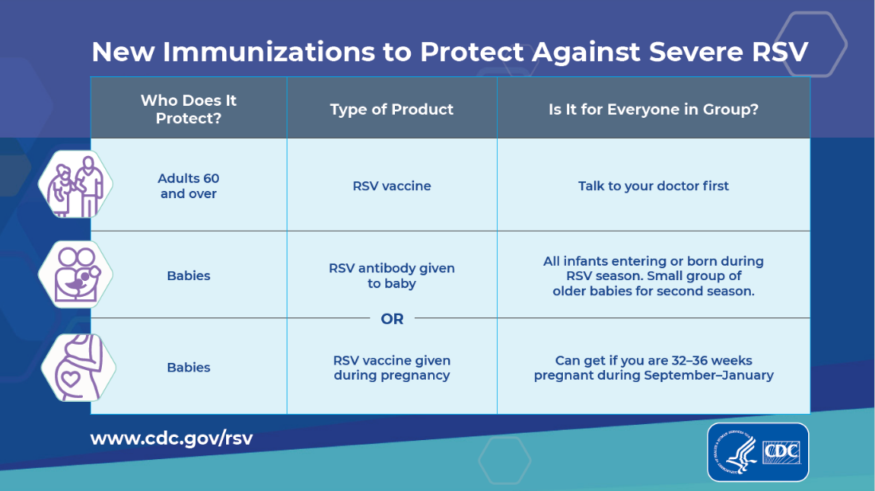
What if mother received RSV Vaccine during Pregnancy?
Most infants will only need protection from either the maternal RSV vaccine or nirsevimab (not both).
However, there may be some situations in which nirsevimab would be recommended for an infant after the mother received an RSV vaccine. Please ask your healthcare provider about this.
Notes:
Photo source: IKC’s Vaccine Highlight Card found: https://immunizekansascoalition.org/documents/Pregnancy%20Vaccine%20Insert%20-%20web.pdf

Slide 67
Which is the better option?
ACOG recommends that you consider the following:
Maternal RSV vaccine gives your baby protection right after birth.
If you get the RSV vaccine, there is one less needle for your baby to get.
Nirsevimab may provide your baby with longer-lasting protection.
Be sure nirsevimab will be available for your baby after birth. (Does your child's doctor stock it? Is it available at your health department?)
Notes:
Resources:
https://www.acog.org/womens-health/experts-and-stories/ask-acog/should-i-get-the-rsv-vaccine-during-pregnancy#:~:text=ACOG%20recommends%20the%20Pfizer%20RSV,first%206%20months%20after%20birth.
Respiratory Syncytial Virus (RSV) Preventive Antibody: What You Need to Know
https://www.cdc.gov/vaccines/vpd/rsv/downloads/Immunization-Information-Statement.pdf
RSV Prevention: RSV Immunizations to Protect Infants and Toddlers
https://www.cdc.gov/rsv/about/prevention.html#protect-children(opens in a new tab)
RSV Vaccination for Pregnant People (web page)
https://www.cdc.gov/vaccines/vpd/rsv/public/pregnancy.html (opens in a new tab)
Respiratory Syncytial Virus (RSV) Immunization Recommendations to Protect Infants and Children (Slide deck)
https://www.cdc.gov/vaccines/vpd/rsv/downloads/RSV-For-HCPs-Caring-For-Pregnant-Patients-508.pdf

Slide 68
Are you afraid of shots?

Slide 69

3 easy ways to manage fear of shot pain
Use distraction.
Take your attention away from the procedure.
Use something that will work for you.
If one isn't working, try different distractions as needed.
Notes:
Take your attention away from the procedure.
Use something that will work for you, e.g., music, videos, cell phone games, books, joking, talking about something else.
If one isn't working, try different distractions as needed.

Slide 70
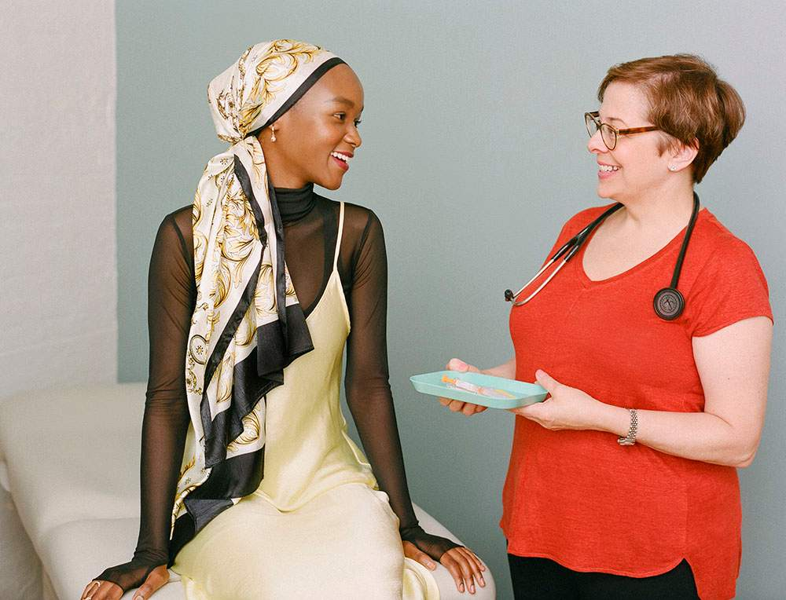
3 easy ways to manage fear of shot pain
2. Rub the skin.
Ask the nurse to rub/stroke your arm near the injection site before and during vaccine injections.
Notes:
Ask the nurse to rub/stroke your arm near the injection site before and during vaccine injections.

Slide 71

3 easy ways to manage fear of shot pain
3. Take deep breaths
Take slow deep breaths and follow a pattern such as breathing in through the nose and out through the mouth.
Notes:
Take slow deep breaths and follow a pattern such as breathing in through the nose and out through the mouth.

Slide 72
Wrap Up

Slide 73
Remember what you learned
Which one of these is false?
  Antibody levels in breast milk are higher if a woman received flu vaccine during pregnancy.
  A flu shot can give you flu.
  After a flu shot it takes about two weeks before a person starts making the antibodies for protection.
Notes:
Which ONE of these is FALSE?
Antibody levels in breast milk are higher if a woman received flu vaccine during pregnancy
A flu shot can give you flu
After a flu shot it takes about two weeks before a person starts making the antibodies for protection.
Correct answer: a flu shot can give you flu.

Slide 74
Remember what you learned
Which one of these is false?
  Antibody levels in breast milk are higher if a woman received flu vaccine during pregnancy.
  A flu shot can give you flu.
  After a flu shot it takes about two weeks before a person starts making the antibodies for protection.
Notes:
The only one that's FALSE is the second one. The flu shot cannot give you the flu.

Slide 75
Remember what you learned
Which one of these is false?
  If you get Tdap after delivery, it is just as worthwhile as getting it during pregnancy.
  Vaccination during pregnancy offers the best protection to your baby until they are old enough to get their own vaccines.
  Babies get their 1st DTaP at 2 months of age, and they have to wait until they are at least 6 months old to get a flu shot.
Notes:
Which ONE of these is FALSE?
If you get Tdap after delivery, it is just as worthwhile as getting it during pregnancy.
Vaccination during pregnancy offers the best protection to your baby until they are old enough to get their own vaccines.
Babies get their 1st DTaP at 2 months of age, and they have to wait until they are at least 6 months old to get a flu shot.

Slide 76
Remember what you learned
Which one of these is false?
  If you get Tdap after delivery, it is just as worthwhile as getting it during pregnancy.
  Vaccination during pregnancy offers the best protection to your baby until they are old enough to get their own vaccines.
  Babies get their 1st DTaP at 2 months of age, and they have to wait until they are at least 6 months old to get a flu shot.
Notes:
The only one that's FALSE is the first. In fact, getting Tdap after delivery is NOT as valuable as vaccination during pregnancy! None of your antibodies get to the baby after delivery.
CDC recommends that pregnant women receive Tdap during the third trimester, between the 27th and 36th week, to pass the greatest number of protective antibodies to the baby before birth. These antibodies will help keep the baby protected during those first few months of life.
Note that, similarly, giving the flu shot during pregnancy helps to protect both mother and child.

Slide 77
Remember what you learned
Which one of these is false?
  COVID-19 vaccine reduces fertility.
  OBs recommend COVID-19 vaccination during pregnancy.
  Pregnant women who get sick with COVID-19 are more likely than nonpregnant women to need an Intensive Care Unit stay.
Notes:
Which one of these is false?
COVID-19 vaccine reduces fertility.
OBs recommend COVID-19 vaccination during pregnancy.
Pregnant women who get sick with COVID-19 are more likely than nonpregnant women to need an Intensive Care Unit stay.

Slide 78
Remember what you learned
Which one of these is false?
  COVID-19 vaccine reduces fertility.
  OBs recommend COVID-19 vaccination during pregnancy.
  Pregnant women who get sick with COVID-19 are more likely than nonpregnant women to need an Intensive Care Unit stay.
Notes:
(From CDC: https://www.cdc.gov/coronavirus/2019-ncov/vaccines/planning-for-pregnancy.html)
There is No Evidence that COVID-19 Vaccines Affect Fertility
There is currently no evidence that vaccine ingredients or antibodies made following COVID-19 vaccination would cause any problems with becoming pregnant now or in the future.
Recent studies have found no differences in pregnancy success rates among women who had antibodies from COVID-19 vaccines or from a recent COVID-19 infection, and women who had no antibodies, including for patients undergoing assisted reproductive technology procedures (e.g., in vitro fertilization).¹¹⁻¹³
A study of more than 2,000 females aged 21-45 years and their partners found that COVID-19 vaccination of either partner did not affect the likelihood of becoming pregnant.¹⁴
Like with all vaccines, scientists continue to study COVID-19 vaccines carefully and will continue to report findings as they become available.

Slide 79
Additional Resources

Slide 80
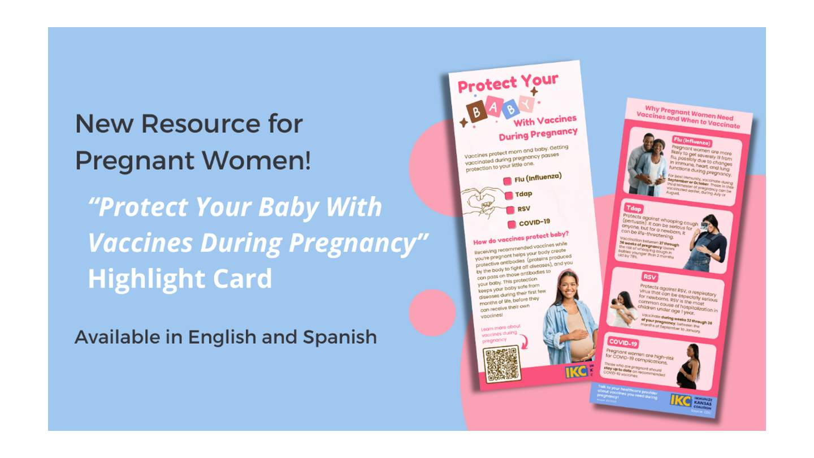
Pregnancy Highlight Cards
View IKC’s Pregnancy Highlight Cards, available on our website in English or Spanish

Slide 81
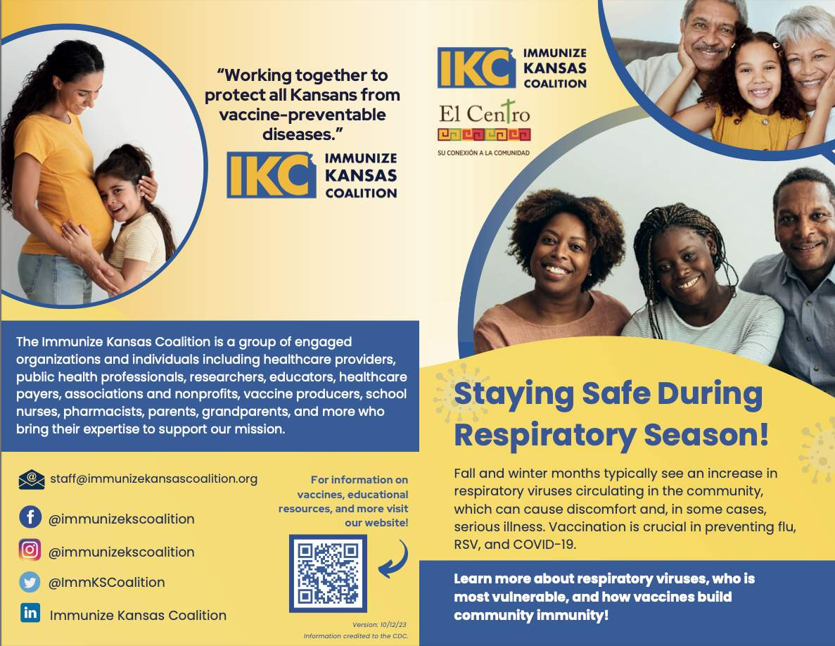
Respiratory Season Information Sheet
Notes:
Another IKC Resource available on our website: https://immunizekansascoalition.org/documents/IKC's%20RSV,%20COVID-19,%20and%20Flu%20Brochure%20-%20English.pdf

Slide 82
Medical and Public Health Resources
The American Academy of Family Physicians
  Statement of Strong Medical Consensus for Vaccination of Pregnant Individuals Against COVID-19
  Fam Pract Manag. 2021 Jul-Aug;28(4):17-20.
The American College of Obstetricians and Gynecologists (ACOG)
  Patient Resources on Immunization
  Increasing Maternal Immunization Rates
  Covid-19 Vaccines during Pregnancy and Breastfeeding
  Should I get the RSV vaccine during pregnancy?
The Association of Women's Health, Obstetric and Neonatal Nurses
  Tdap Vaccine Video
  Influenza Vaccine Video
The Centers for Disease Control and Prevention
  Pregnancy and Vaccination
  Immunize.org
  Pregnancy and Vaccines
Vaccinate Your Family
  Resources for Parents and Parents to Be
Notes:
Another IKC Resource available on our website: https://immunizekansascoalition.org/documents/IKC's%20RSV,%20COVID-19,%20and%20Flu%20Brochure%20-%20English.pdf

Slide 83

Understanding why you need vaccines during pregnancy is one more step
to protecting your baby.

